Slide 1
Mrs Otto
Blueberry class

Slide 2
Pupil priorities
I practise being confident
Speaking out in class and assembly
Not being afraid to take a chance, even though the answer might be wrong
Expressing how I feel, even when I’m feeling sad or upset
2. I am a reader
I always have books to read at home and at school
I know a range of genres and authors and have a favourite
I read for pleasure
3. I live by the Addison Values
I know the words: Respect, Responsibility, Perseverance. Honesty and Friendship and I know what they represent
I try to make my choices like the ‘Addison Characters’ would – in and out of school
I encourage others to be the best they can be

Slide 3
Key information
School starts at 8:30am and gates close at 8:45am. Late children must go round to the late gate (on Addison Gardens)
You can buy school uniform from the ‘uniform’ tab on the school website
School finishes at 3pm
PE is on Tuesdays

Slide 4

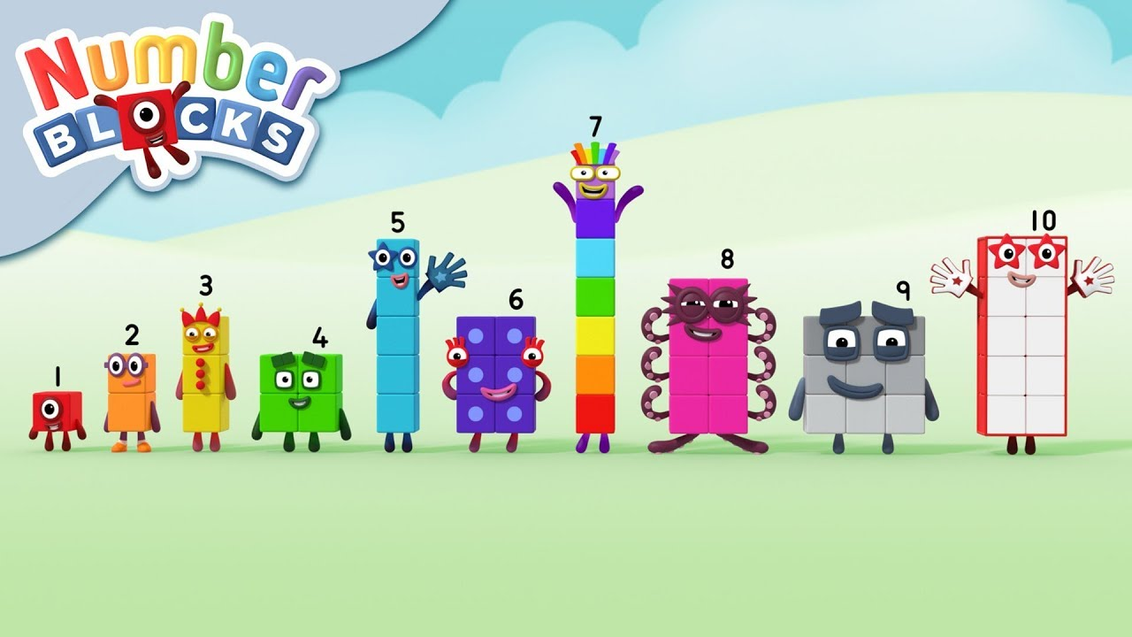

Maths – key learning
To match objects, identify pairs and sets and rule the ‘odd one out’
To be able to read and count numbers up to 10 and say the numbers in order
To be to able to count out two lots of objects and work out how many there are altogether
To be able to compare two numbers and say which is more and which is less
Links: https://www.ncetm.org.uk/
Concrete Pictorial Abstract
Literacy – key learning
To give meaning to mark making
To link set 1 sounds to letters
To hear initial sounds in words
To learn and retell a story
To be able to write my own name
Key information:
Please read EVERY day with your child
Practice letter formation of sounds covered
Practice counting (as you climb stairs/ are eating fruit/ reading picture books/ etc.)
Practice writing own name

Slide 5



Key Texts
Ruby’s Worry by Tom Percival
Owl Babies by Martin Wadell
Funnybones by Janet and Allan Ahlberg
What Makes Me A Me? by Ben Faulks
I Like Myself by Karen Beaumont
Foundation Subject Learning
All About Me
I understand how I am similar to and different from others.
I can talk about an event I have experienced (e.g. my weekend).
Values
Respect
Nurture
Responsibility
Generosity
Kindness
I can describe myself.
I can talk about how I am feeling.
Experiences
To talk about ourselves and our family based on photos of ourselves.
I can order pictures of myself on a timeline.
I can talk about my family.

