Slide 1
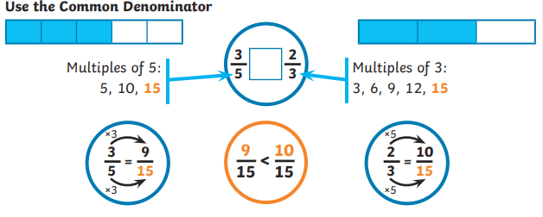
Year 6 – Autumn 2
I can add and subtract fractions
The factors of a number are all numbers which divide it with no remainder.
E.g. the factors of 24 are 1, 2, 3, 4, 6, 8, 12, and 24. The factors of 56 are 1, 2, 4, 7, 8, 14, 28 and 56.
The common factors of two numbers are the factors they share.
E.g. the common factors of 24 and 56 are 1, 2, 4 and 8.
The greatest common factor of 24 and 56 is 8.
Key Vocabulary
factor
common factor
multiple
greatest common factor
Top Tips
The secret to success is practising little and often. Use time wisely. Can you practise these KIRFs while walking to school or during a car journey? If your child is not yet confident with identifying factor pairs of a number, you may want to refer to the Year 5 Summer 2 sheet to practise this first. If you would like more ideas, please speak to your child’s teacher.
There are many online games to practise finding the greatest common factor, for example:
http://www.fun4thebrain.com/beyondfacts/gcfsketch.html
Choose two numbers. Take it in turns to name factors. Who can find the most?

